Slide 1
Agenda
Objective
Data
Methods
Linear Regression
Decision tree
KNN
Logistic regression
KMEANS
Results
Comparisons
Observations

Slide 2
Objectives
Overview of the Dataset
Data Preprocessing
Relationships in the data set with visualization
Prediction task is to determine whether a person makes over 50K a year
Evaluating the performance of the models.

Slide 3
Overview of Dataset
Census Income Dataset from UCI machine learning repository
48842 instances (Train = 32561, Test = 16281)
Attributes: 14
Continuous: Age, fnlwgt, education-num, capital-gain, capital-loss, hours-per-week
Nominal: work class, education, marital-status, occupation, relationship, race, sex, native-country
45220 after data cleaning
Salary - 2 classes : >50K, <=50K
Missing Values:
Work class
Occupation
Native-country

Slide 4
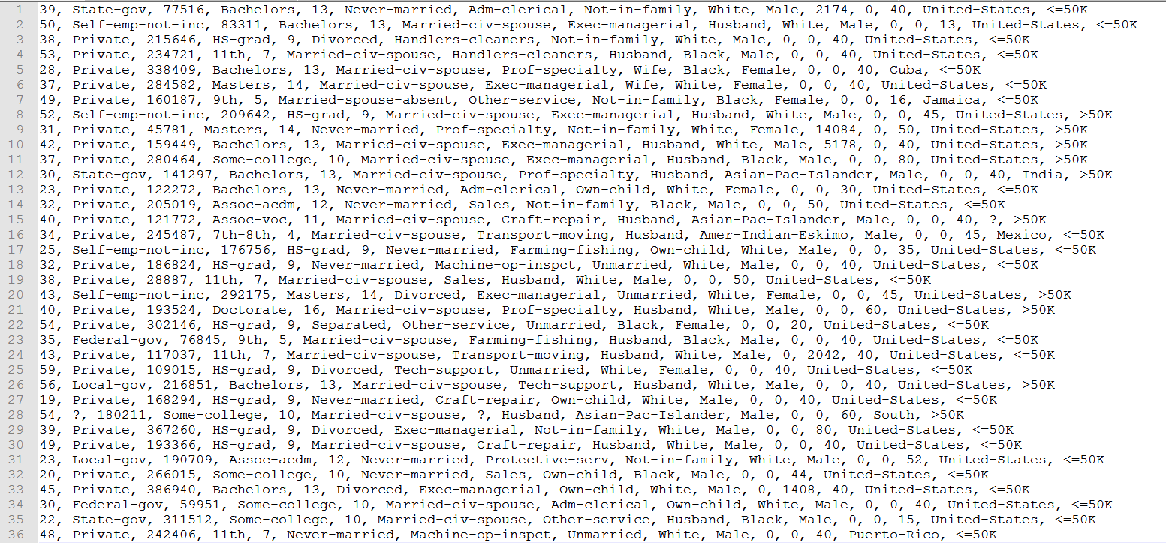
Data Snapshot

Slide 5
Data Preprocessing
Preprocess the data for effective datamining.
Consider how to deal with missing values
Consider which attributes are relevant
Removed fnlwgt attribute (Final weight)
Removed education-number attribute
Mirror attribute to education
Handling missing values
Removed duplicates

Slide 6
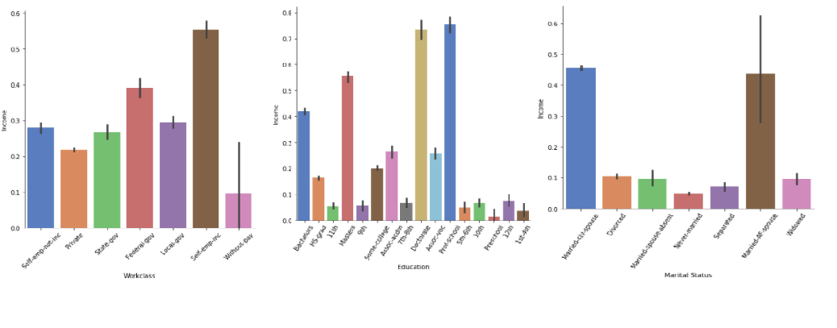
Relationships in the data set with visualization

Slide 7
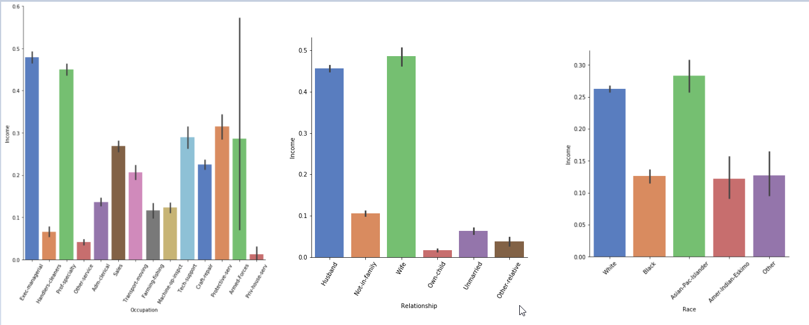
Relationships in the data set with visualization
Cont..

Slide 8
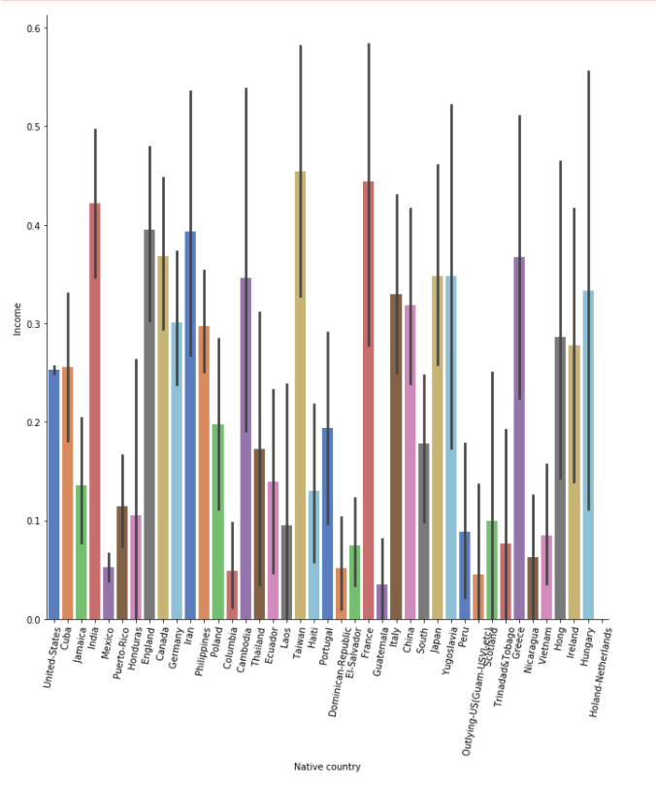
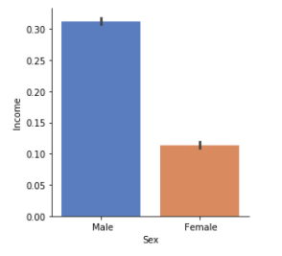
Relationships in the data set with visualization
Cont..

Slide 9
Methods

Slide 10
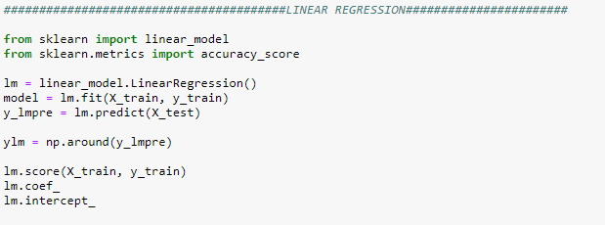
Linear Regression
Linear regression attempts to model the relationship between two variables by fitting a linear equation to observed data. One variable is an explanatory variable, and the other is a dependent variable.
In this project, Income is explanatory variable and other variables are dependent variables.

Slide 11
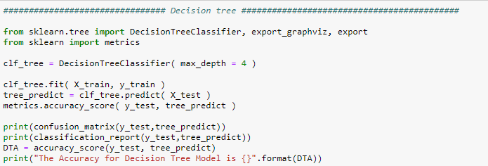
Decision tree
A decision tree is a flowchart-like structure in which each internal node represents a "test" on an attribute (e.g. whether a coin flip comes up heads or tails), each branch represents the outcome of the test, and each leaf node represents a class label (decision taken after computing all attributes).

Slide 12
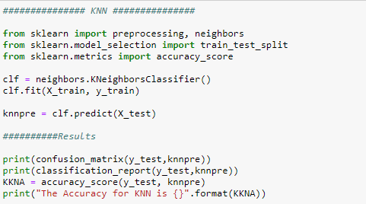
KNN
K-Nearest Neighbors (KNN) is one of the simplest algorithms used in Machine Learning for regression and classification problem. KNN algorithms use data and classify new data points based on similarity measures (e.g. distance function). Classification is done by a majority vote to its neighbors.

Slide 13
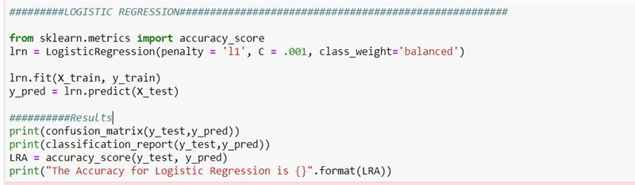
Logistic regression
Logistic regression is a classification algorithm, used when the value of the target variable is categorical in nature. Logistic regression is most used when the data in question has binary output, so when it belongs to one class or another, or is either a 0 or 1.

Slide 14
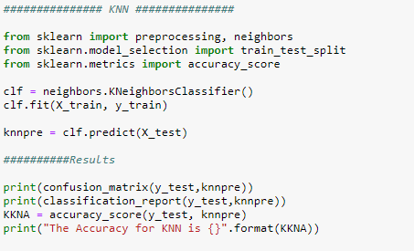
KMEANS
k-means clustering is a method of vector quantization, originally from signal processing, that aims to partition n observations into k clusters in which each observation belongs to the cluster with the nearest mean (cluster centers or cluster centroid), serving as a prototype of the cluster.

Slide 15
Results
MODEL | Accuracy
Linear Regression | 83%
Decision Tree | 83%
KNN | 81%
Logistic Regression | 72%
K Means | 28%

Slide 16
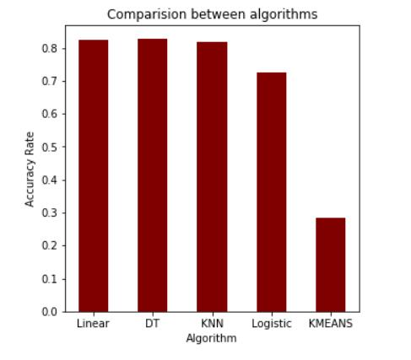
Model Comparison

Slide 17
Learning Outcomes
Pre-processing the dataset has an impact over the accuracy of the algorithms.
We tried normalizing the data, removing the null values and performing the one-hot encoding, due to which the accuracy of the algorithms has been increased.
We need to train our model with different algorithms and need to choose the algorithms which gives better accuracy and prediction with the dataset.
By treating the data and replacing the missing data with either of the measure of central tendency we could observe that the models gave better results.
Visualizing the data helps us give more insights from the data comparing the outcome variable with the dependent variables

